Slide 1
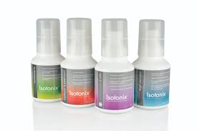
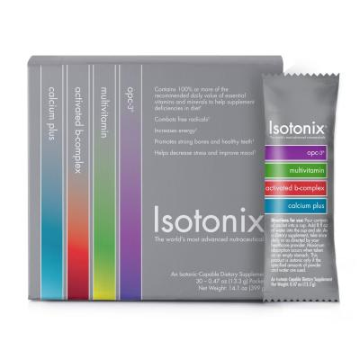
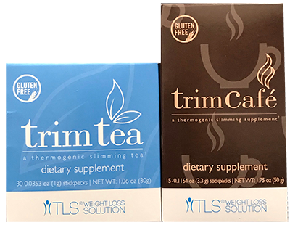
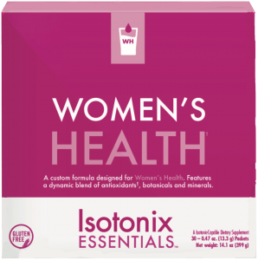
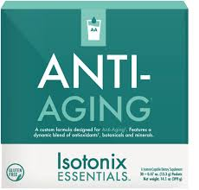
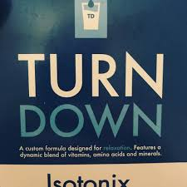
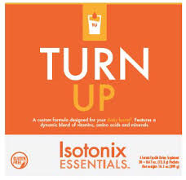
WHICH KIT
YOU?
IS RIGHT FOR
Convenient On-The-Go Packets with Four Essential customer favorites
Daily Essential Kit 90 Servings Contains:
1 Isotonix® Multivitamin 300 g bottle
1 Isotonix Activated B-Complex 300 g bottle
1 Isotonix OPC-3 300 g bottle
1 Isotonix Calcium Plus 300 g bottle
Isotonix Daily Essential Packets: Single Box (30 packets) Isotonix OPC-3® Isotonix® Multivitamin Isotonix® Activated B-Complex Isotonix® Calcium Plus
Trim Tea / Trim Cofe ( Pick 1)
3 Trim Tea Box or 3 Trim Café Box
COST | $180.00
COST | $77.00
COST | $119.85
$429.95
Isotonix Women's Health – 30 packets
COST | $79.95
Isotonix Antiaging 30 packets – 30 Packets
COST | $99.95
Isotonix Turn Down – 30 packets
COST | $69.95
Isotonix Turn up 30 packets – 30 Packets
COST | $79.95
Credit Card Option:
Name: ________________________________________________Email: _________________________________ Phone: __________________________
Address:___________________________________________________________City: _____________________________ State: ___ Zip :____________
Credit Card #: _________________________________________________Exp Date:______________ CVV: _________________
*These statements have not been evaluated by the Food and Drug Administration. These products are not intended to diagnose, treat, cure or prevent any disease

Slide 2
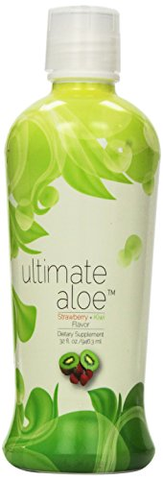
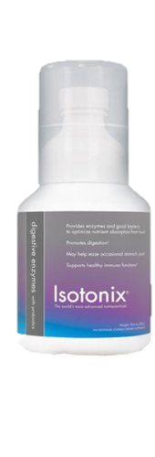
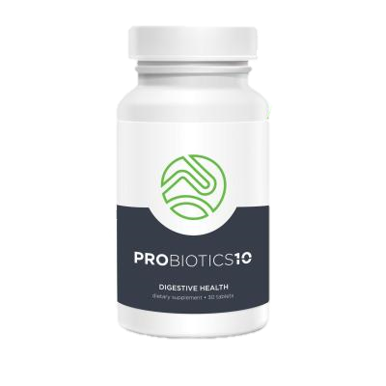
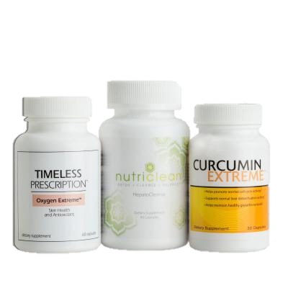
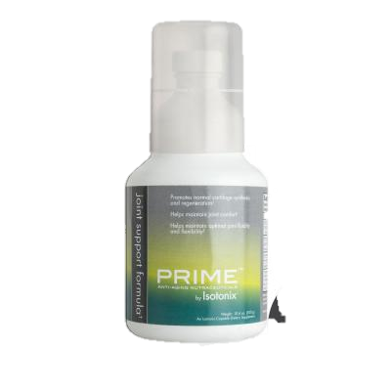
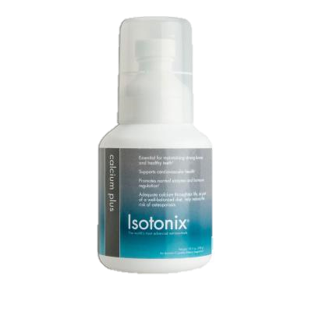
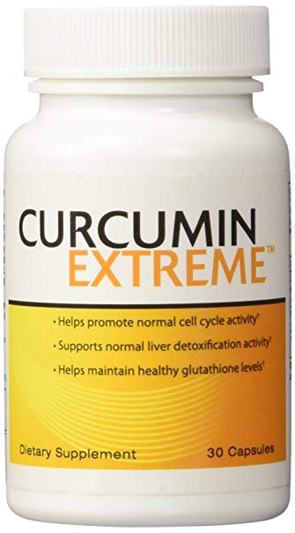
WHICH KIT
YOU?
IS RIGHT FOR
Convenient On-The-Go Packets with Four Essential customer favorites
Daily Essential Kit 90 Servings Contains:
1 Isotonix® Multivitamin 300 g bottle
1 Isotonix Activated B-Complex 300 g bottle
1 Isotonix OPC-3 300 g bottle
1 Isotonix Calcium Plus 300 g bottle
Isotonix Daily Essential Packets: Single Box (30 packets) Isotonix OPC-3® Isotonix® Multivitamin Isotonix® Activated B-Complex Isotonix® Calcium Plus
Digestive Kit Contains:
1 Ultimate Aloe Juice® Strawberry Kiwi Flavor 32 oz
1 Probiotics 10 : 30 tablets
1 Isotonix Digestive Enzymes with Probiotics 300mg
COST | $180.00
COST | $77.00
COST | $89.85
$429.95
Complete Detox Kit Contains :
Curcumin Extreme (30 Servings);
Prescription Oxygen Extreme (30 Servings) NutriClean Hepatocleanse (30 Servings)
Join Health Contains:
Isotonix Prime Joint Isotonix Calcium Curcumin Extreme (30 Servings
COST | $95.00
COST | $146.40
Credit Card Option:
Name: ________________________________________________Email: _________________________________ Phone: __________________________
Address:___________________________________________________________City: _____________________________ State: ___ Zip :____________
Credit Card #: _________________________________________________Exp Date:______________ CVV: _________________
*These statements have not been evaluated by the Food and Drug Administration. These products are not intended to diagnose, treat, cure or prevent any disease

Slide 3
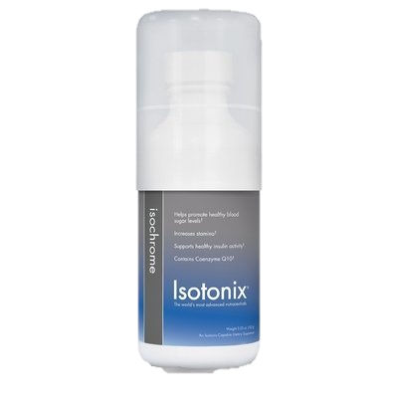
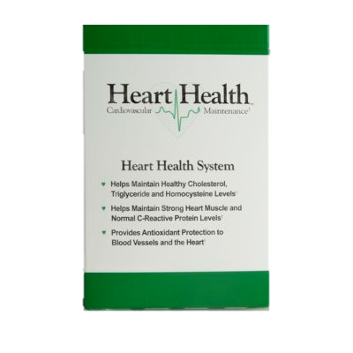
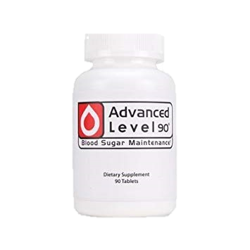
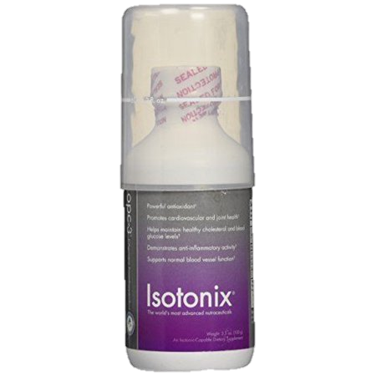
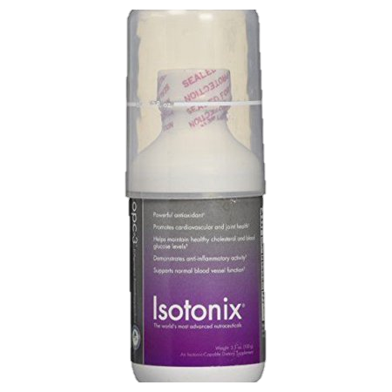
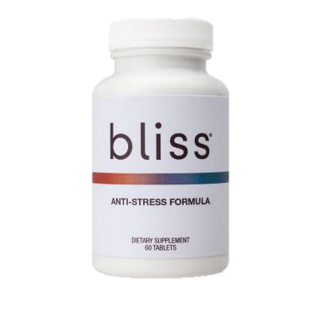
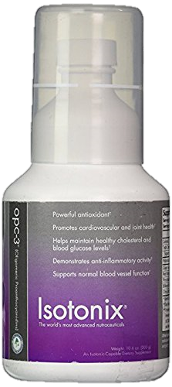
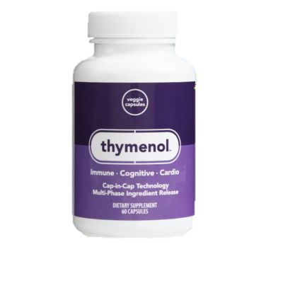
WHICH KIT
YOU?
IS RIGHT FOR
Blood Sugar Balance Contains:
1 Isotonix® Isochrome 100g bottle
1 Level 90 ( 30 servings)
Cholesterol Maintenance 1 Isotonix® OPC-3® ( 30 Serving) 1 Heart Health kit ( 30 packets)
Healthy Blood Pressure Support:
1 Bliss® Anti-Stress Formula ( 30 servings)
1 Isotonix® OPC-3® (30 Servings)
COST | $89.45
COST | $141.90
COST | $70.7
$429.95
Stress Kit Contains:
1 Bliss : 30 Servings
1 Thymenol : 30 Servings
Seasonal Kit
1 Isotonix® OPC-3® ( 90 Serving 1 Curcumin Extreme (30 Servings
COST | $108.70
COST | $141.90
Credit Card Option:
Name: ________________________________________________Email: _________________________________ Phone: __________________________
Address:___________________________________________________________City: _____________________________ State: ___ Zip :____________
Credit Card #: _________________________________________________Exp Date:______________ CVV: _________________
*These statements have not been evaluated by the Food and Drug Administration. These products are not intended to diagnose, treat, cure or prevent any disease

Slide 4
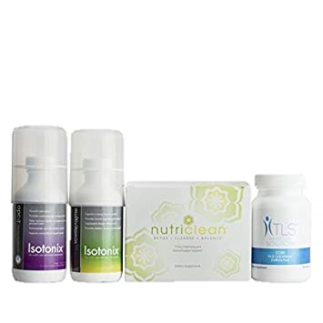
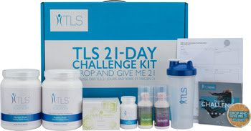
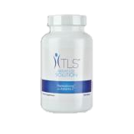
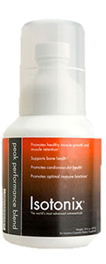
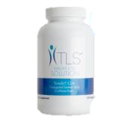
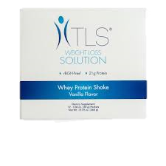
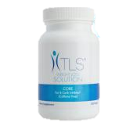
WHICH TLS KIT
YOU?
IS RIGHT FOR
TLS® 21-Day Challenge Kit: NutriClean 7-Day Cleansing System; TLS CORE;
Isotonix OPC-3 (30 Servings);Isotonix Multivitamin (30 Servings); 2 TLS Nutrition Shakes – 1 Vanilla; 1 Chocolate; Challenge Guide; Tracking Sheet; Shaker Bottle and Button
TLS 4 weeks Kit: 1 Isotonix® OPC-3® ( 30 Serving) 1 NutriClean 7-Day Cleansing System;
1 TLS CORE;
Multivitamin (30 Servings);
Trim Tea / Trim Cofe ( Pick 1)
3 Trim Tea Box or 3 Trim Café Box
COST | $119.85
COST | $199.00
COST | $176.65
$429.95
The Fat Burner Kit: ( Pick 1)
CLA And ThermoChrome with Trim Tea/ Trim Café
CLA And Garcinia Combogia with Trim Tea/ Trim Cafe
Workout Kit
TLS CLA ( 90 Servings) TLS ThermoChrome ( (90 Servings)
Isotoinx Peak Performance ( 90 servints)
COST | $127.00
COST | $160.89
Credit Card Option:
Name: ________________________________________________Email: _________________________________ Phone: __________________________
Address:___________________________________________________________City: _____________________________ State: ___ Zip :____________
Credit Card #: _________________________________________________Exp Date:______________ CVV: _________________
*These statements have not been evaluated by the Food and Drug Administration. These products are not intended to diagnose, treat, cure or prevent any disease

Slide 5
Starter Package
Fast Start Program: $429.⁹⁵ + Tax with Free Shipping (Includes $129.⁹⁵ Subscription Fee)

